Slide 1
“Organic” *
Organic agriculture is an ecological production management system that promotes and enhances biodiversity, biological cycles and soil biological activity. It is based on minimal use of off-farm inputs and on management practices that restore, maintain and enhance ecological harmony.
*USDA National Organic Standards Board (1995)

Slide 2
Organic Labeling Processed Food
100% Organic“ = only organic ingredients
Organic” = 95%+ organic ingredients
“Made With Organic Ingredients” = 70%+ organic ingredients
“Contains Organic ___________” listed in “Ingredients” on container.

Slide 3
Organic Processing
Organic and non-organic produce can’t touch anywhere in the pipeline from harvesting to the produce displays in store.
All growers, handlers, and processors must be certified by USDA

Slide 4
Two Processing Methods
Water (or Steam) Bath
High Acid—jam, jelly, fruit & pickled stuff
Immerse jars in boiling water or steam bath
—212 F degrees
Follow timing directions (“Stocking Up” = Good Book)
Usually about 20 minutes pints, 25 minutes quarts

Slide 5
Water/Steam Bath-High Acid Examples
Begin simple—Jelly and Jam, you can’t hurt yourself
Pickles
Fruit—peaches, pears, apricots
Catsup (Ketchup?)
Whole tomatoes and sauce and paste

Slide 6
Two Processing Methods
Pressure Cooker
Low Acid—Vegetables mostly
Place jars in Pressure Cooker in 2 inches of water, use 10psi = 240 degrees—kills more bacteria
Follow timing directions (“Stocking Up” = Good Book)
Usually about 20 minutes pints, 25 minutes quarts

Slide 7
Pressure Cooker-Low Acid Examples--Vegetables mostly
Spaghetti Sauce—Your own tomatoes, garlic, onions, celery.
Salsa
Green Beans
Beets
Zucchini in Sauce

Slide 8
Preserving your own food Freezer
Save fruit pulp and juice to make jam/jelly in the winter.
Freeze strawberries and blueberries
Freeze chicken stock from home grown chickens
When I make chili or soup, I double or triple the recipe and freeze surplus.
Easiest way to preserve salsa
slice and freeze sweet and hot peppers
Most freezer stuff is good for months, meat with fat deteriorates more quickly.

Slide 9
Storing whole foods
Onions, garlic, and potatoes will keep most of the winter in a cool place.
Apples and pears keep pretty well
Winter squash keeps until January

Slide 10
Best Information Source:
http://www.uga.edu/nchfp/publications/publications_usda.html
(a link on Geo 300 website)

Slide 11
Canned/Stored for winter
In our “fruit room” we store winter
food, some canned some fresh—like garlic, potatoes, and onions

Slide 12
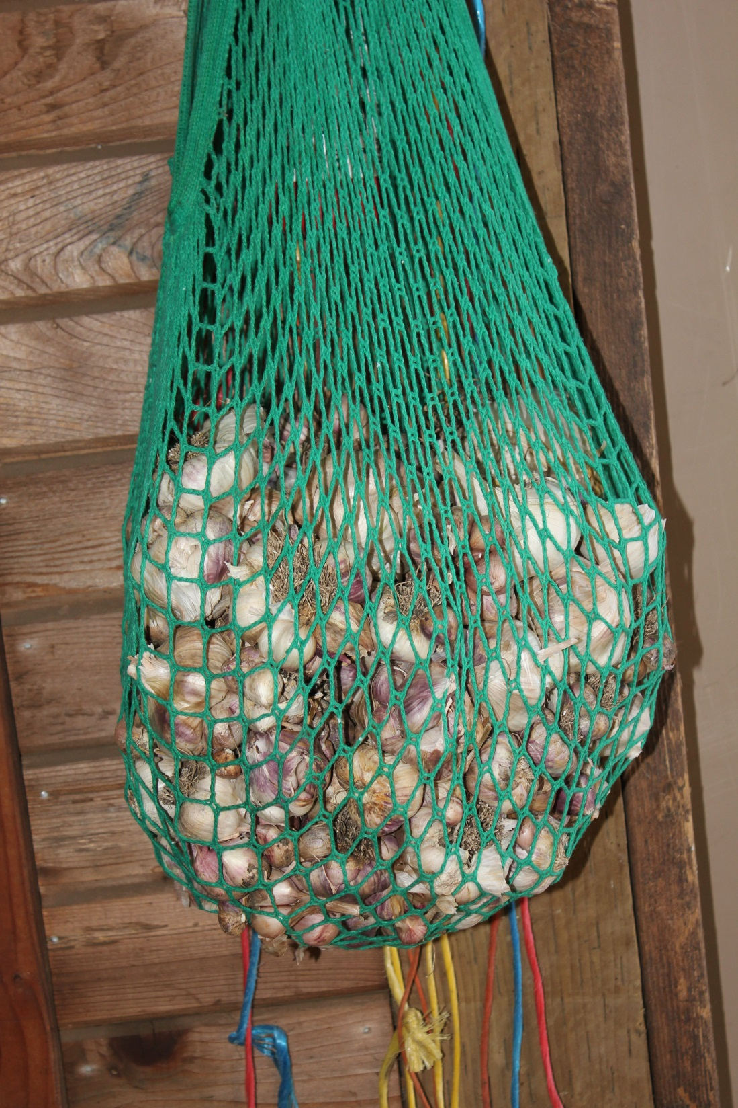
Garlic for winter
It needs a cool
and dry place
to keep. It will
last all winter.

Slide 13
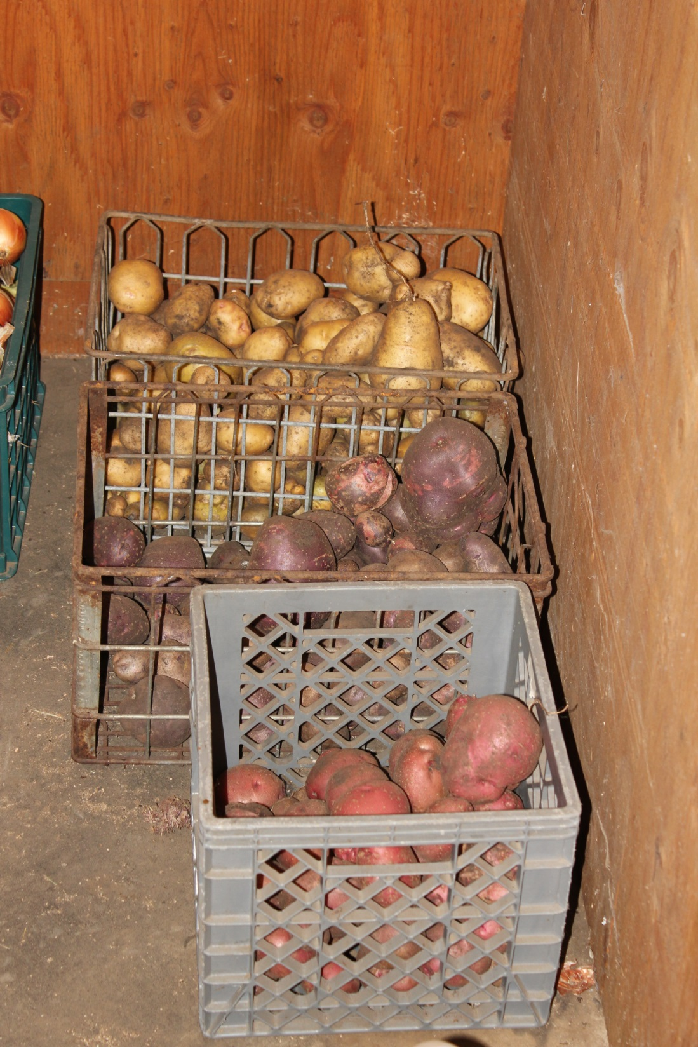
About 80 pounds of potatoes 2017
Three varieties.

Slide 14
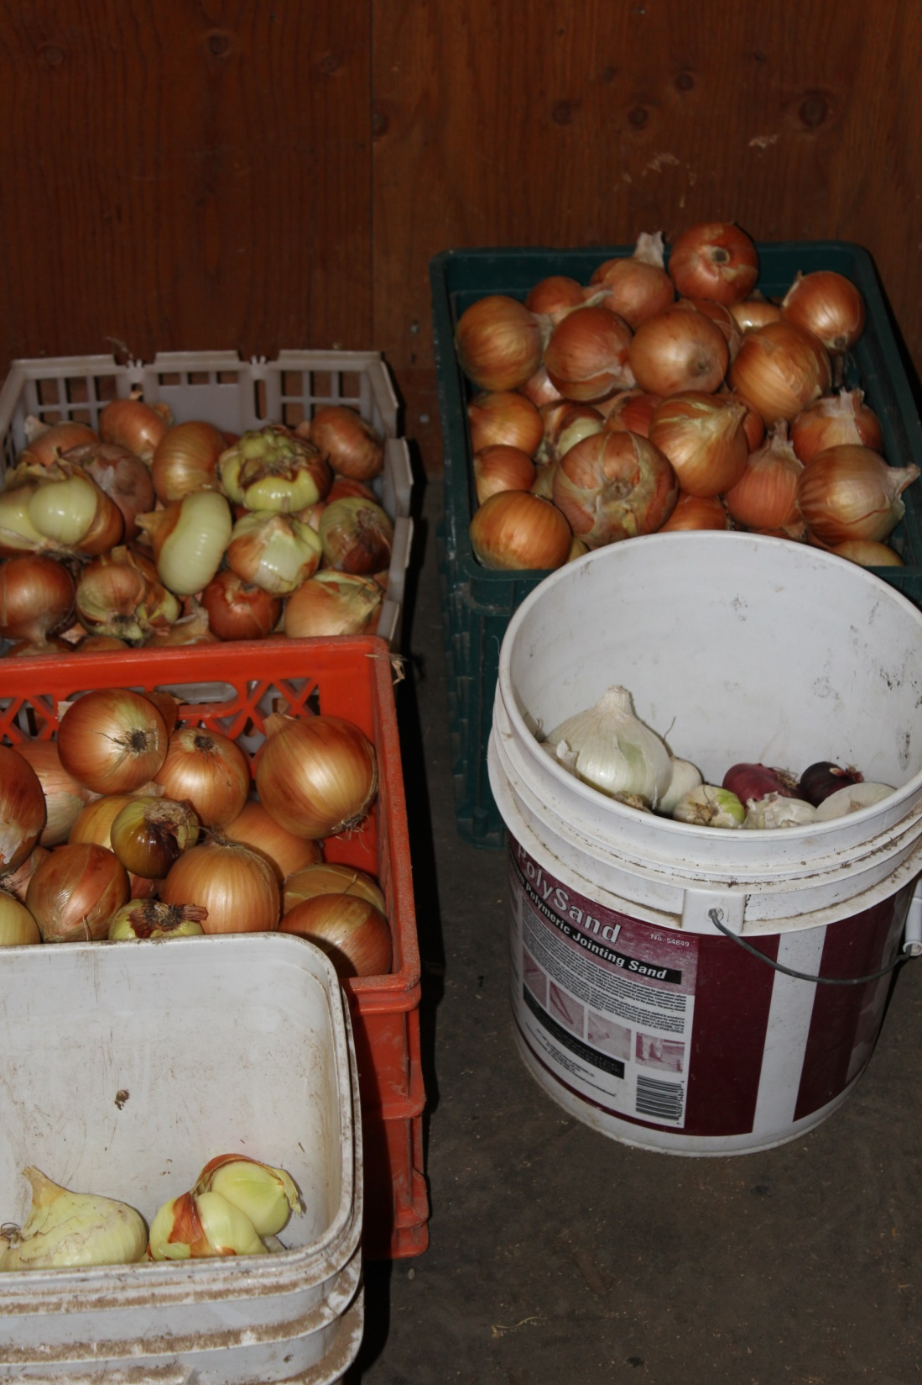
About 80 pounds of onions
Three varieties—yellow, red,
and white. Mostly yellow.

Slide 15
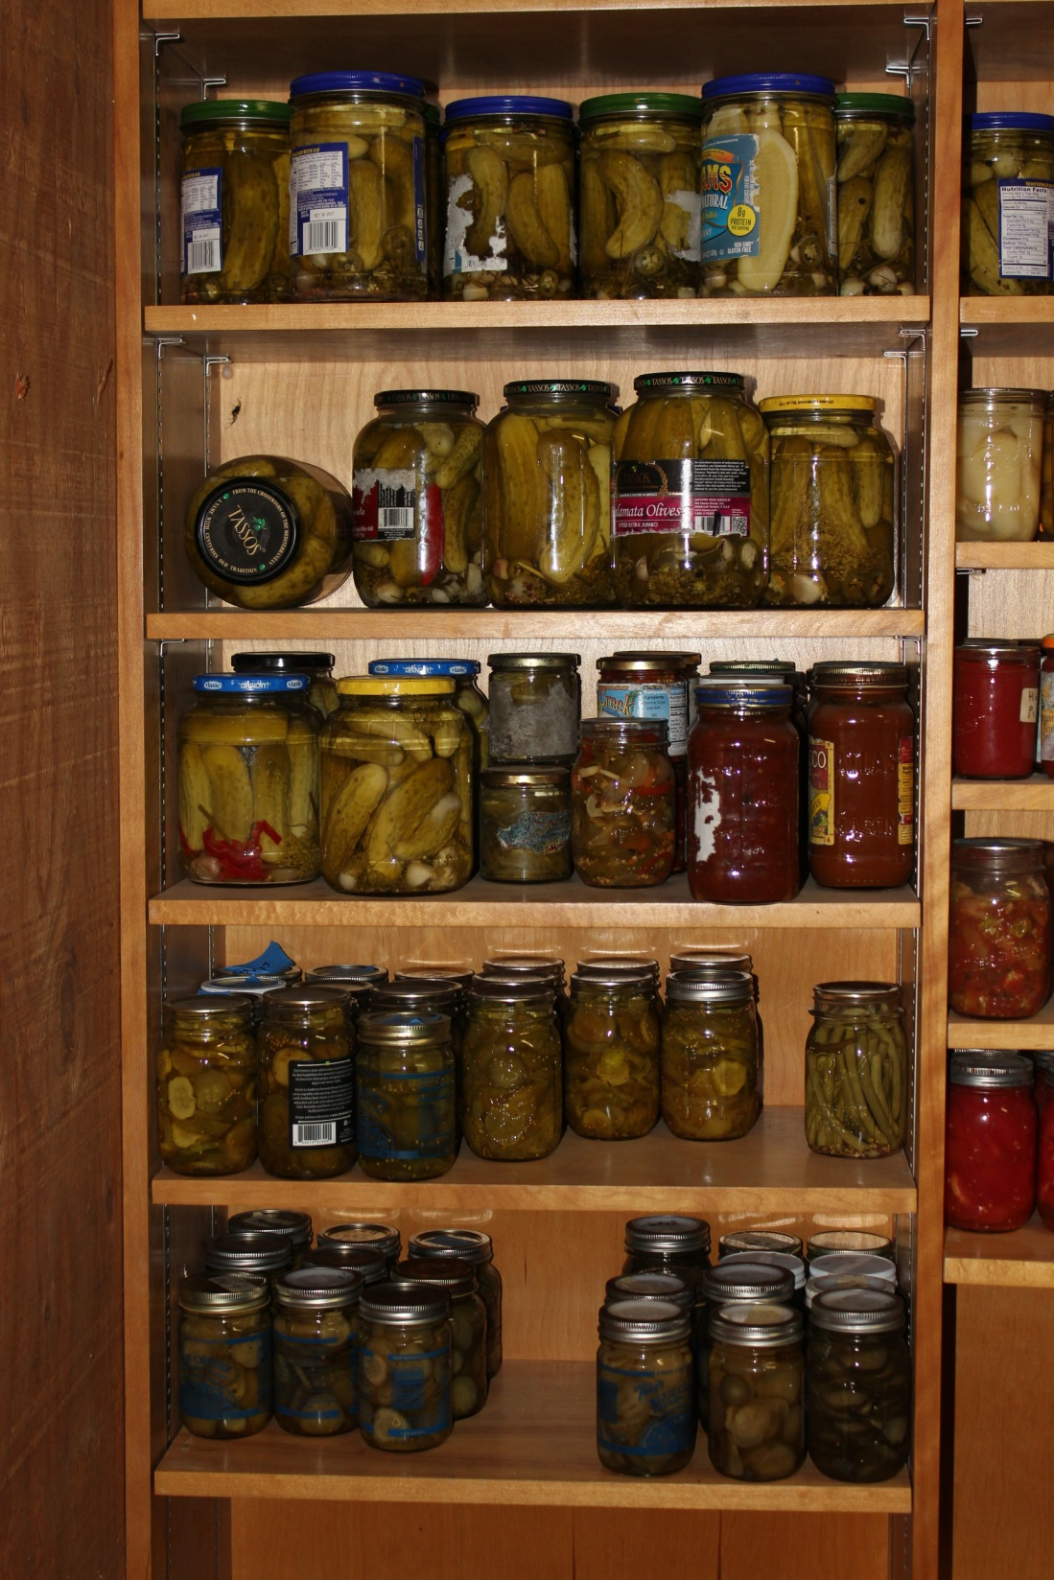

Slide 16
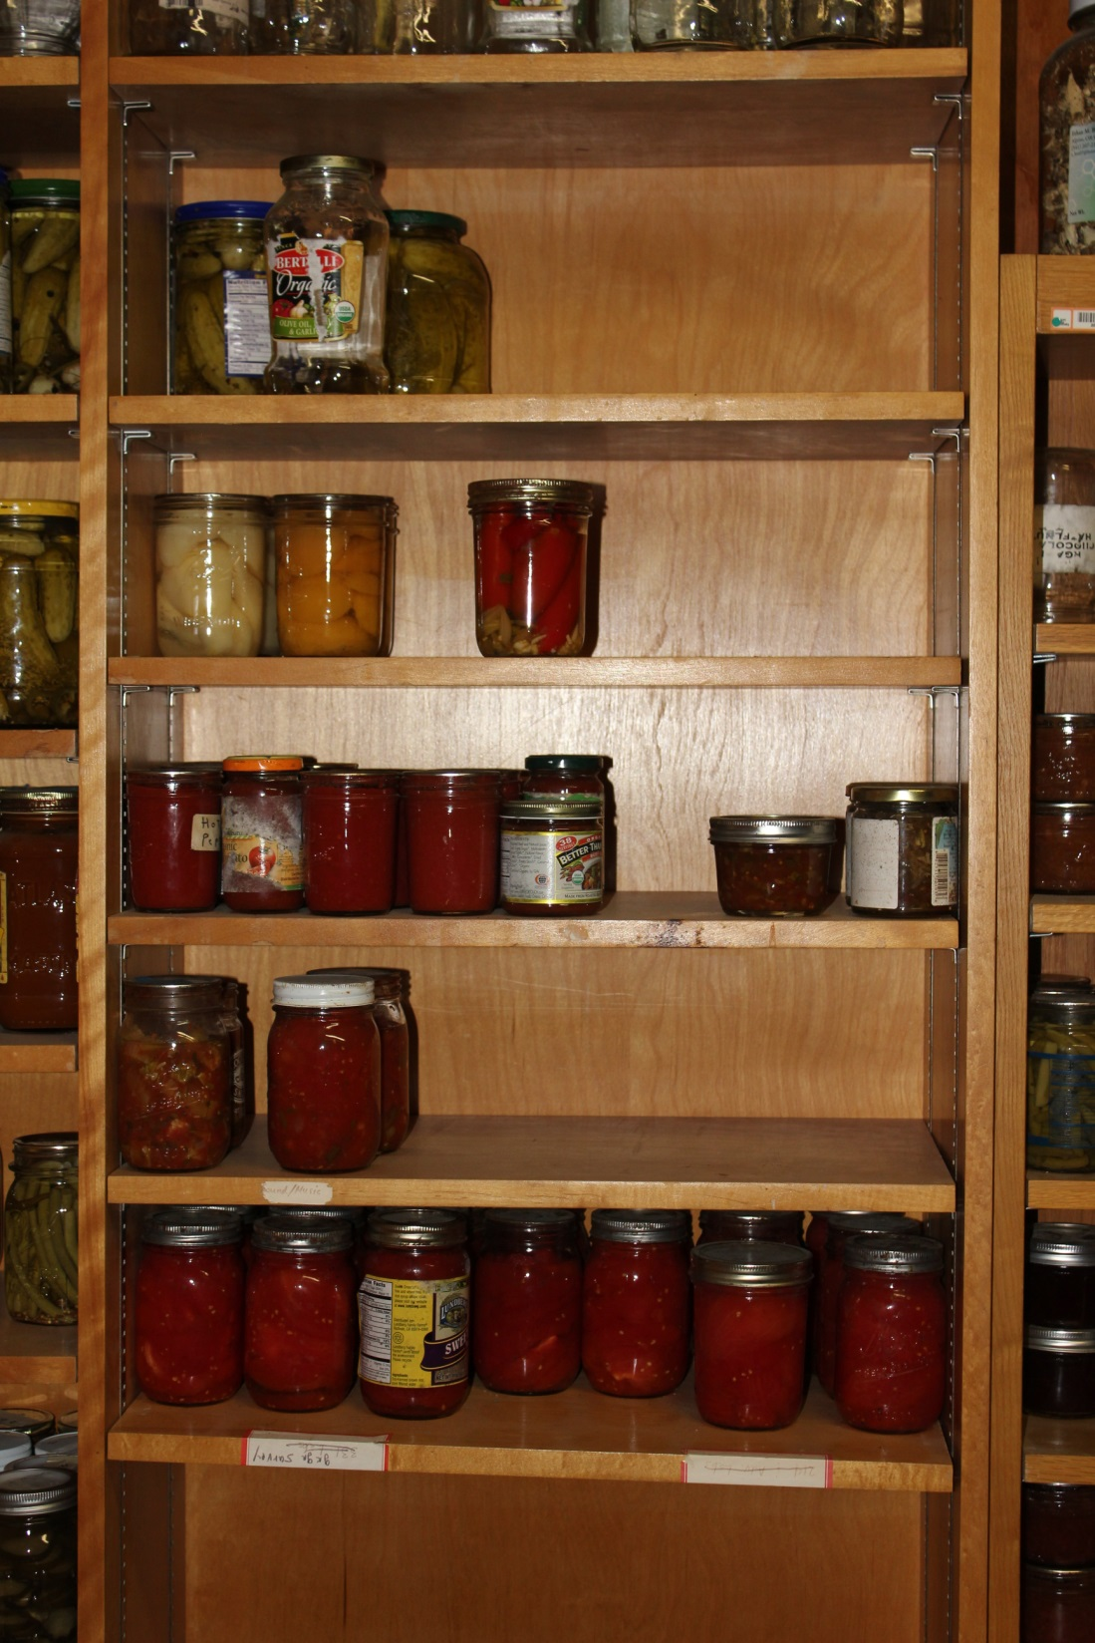

Slide 17
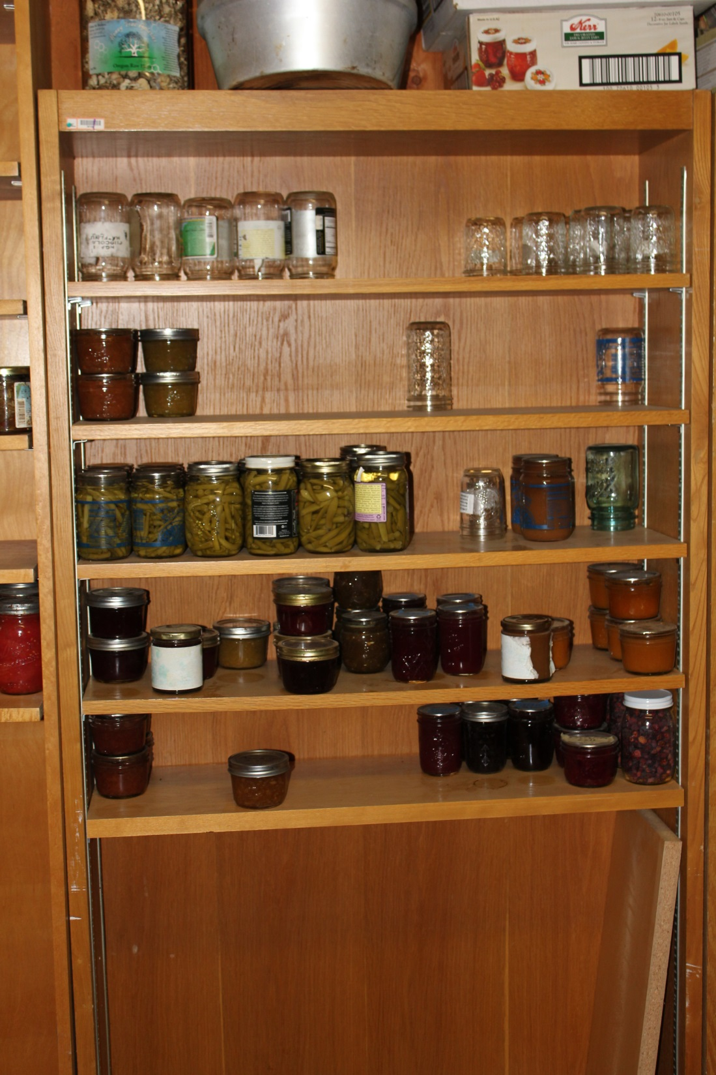

Slide 18
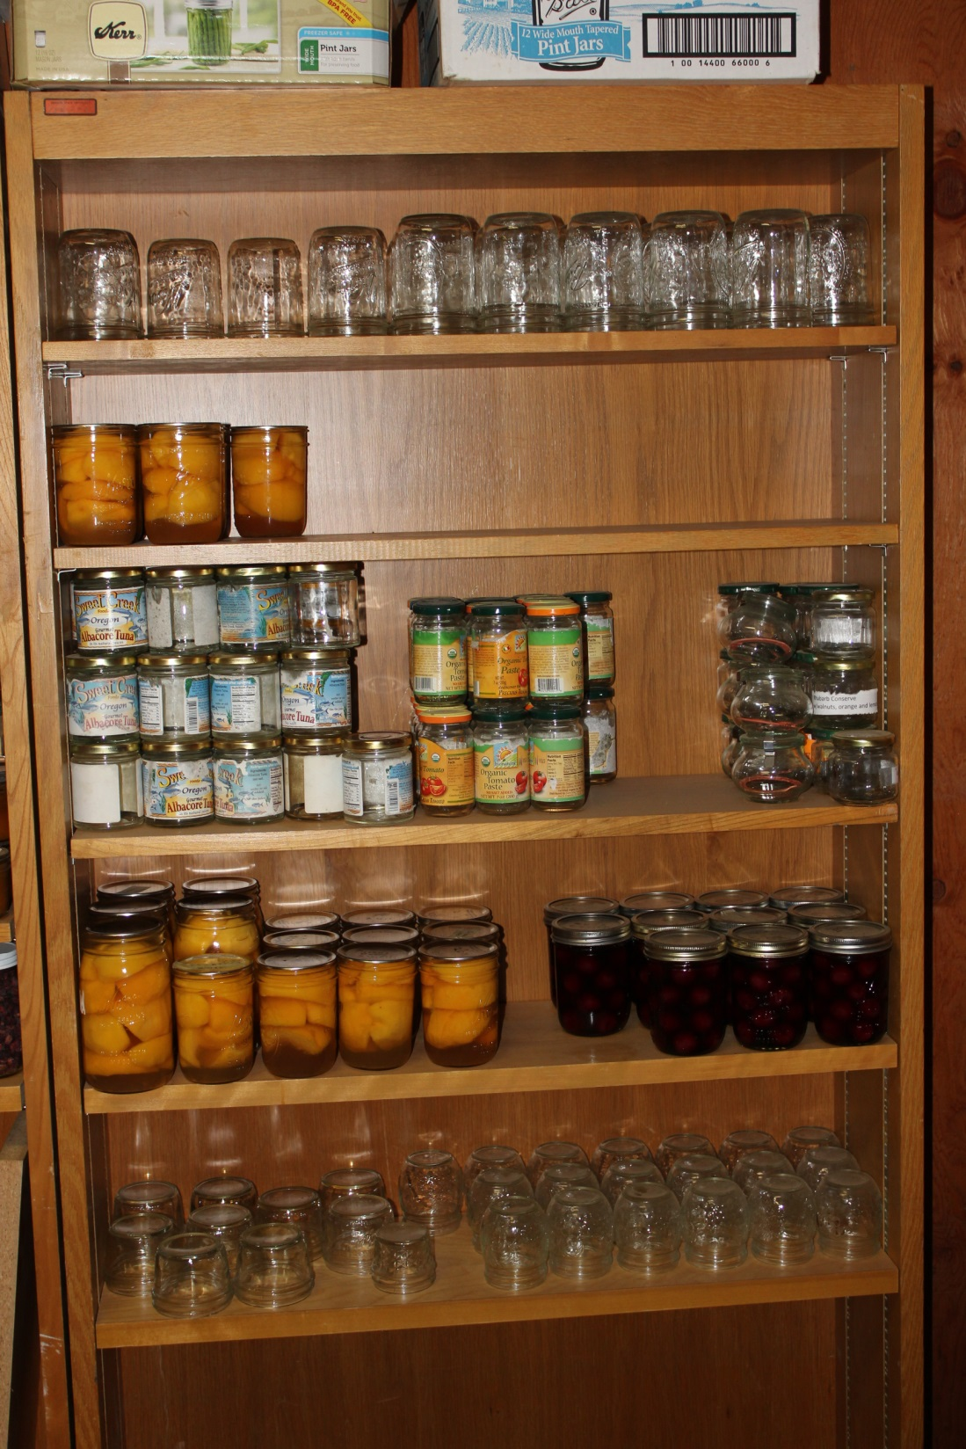

Slide 19
